Slide 1

Chicago Taxi Trips
MSDS 7330 Term Paper – Group D
Josh Balson
Cam Lu
Hieu Nguyen
Notes:
To change the image on this slide, select the picture and delete it. Then click the Pictures icon in the placeholder to insert your own image.

Slide 2
Abstract
The purpose of this research is to analyze taxi rides taken in Chicago from 2013 to 2016 to determine whether the city of Chicago is “centralized”
We will also analyze the question, “are taxis competing with the metro system by covering similar routes or supplementing metro routes by getting people to and from train stations?”
We will answer this question by analyzing the ratio of taxi rides where the destination was either to or from downtown compared to all taxi rides taken during the same time period
In order to study the questions above, we will use a data set provided by Kaggle (https://www.kaggle.com/chicago/chicago-taxi-rides-2016)
We also used the full data set provided by the City of Chicago (https://data.cityofchicago.org/Transportation/Taxi-Trips/wrvz-psew)

Slide 3

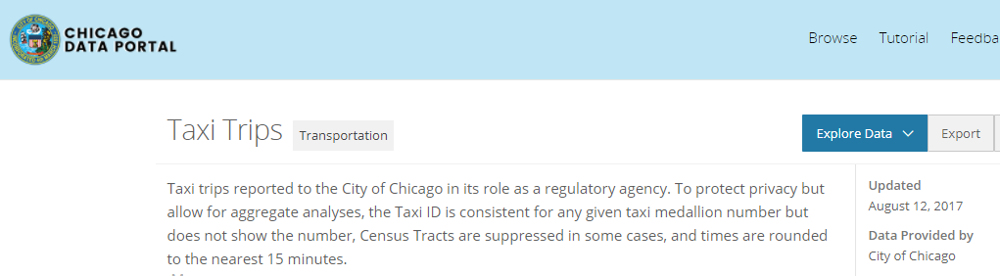
Background/Related Work
Data set published by Kaggle
For 2016 only
Kaggle’s data set replaces lat/lon with ‘community areas’. Makes it more difficult to perform the analysis around pick-up/drop-off locations
Data set contains many other metrics, such as fare, trip distance, trip duration, etc.
Kaggle consumers have used this to analyze many things, such as rush hour heat maps, fare vs. ride time, etc.
However, not a lot around our analysis
The city of Chicago keeps a continuously updated data set
2013 through Aug. of 2017
Maintains a dashboard of the data
Trip volume, duration, fare, drop-off/pick-up
https://data.cityofchicago.org/Transportation/Taxi-Trips-Dashboard/spcw-brbq
Many other data sets on this portal besides taxi rides: Admin/Community/Education…
Very interesting!
https://data.cityofchicago.org/

Slide 4
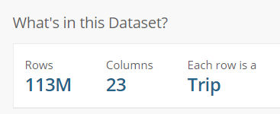


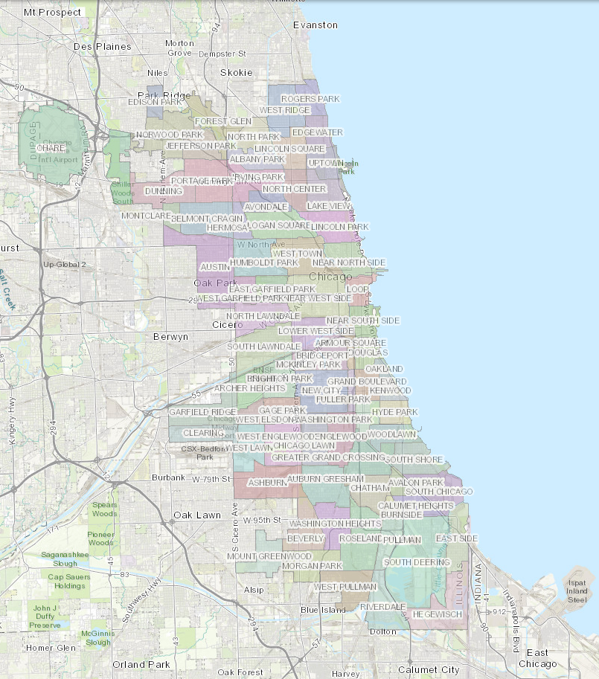
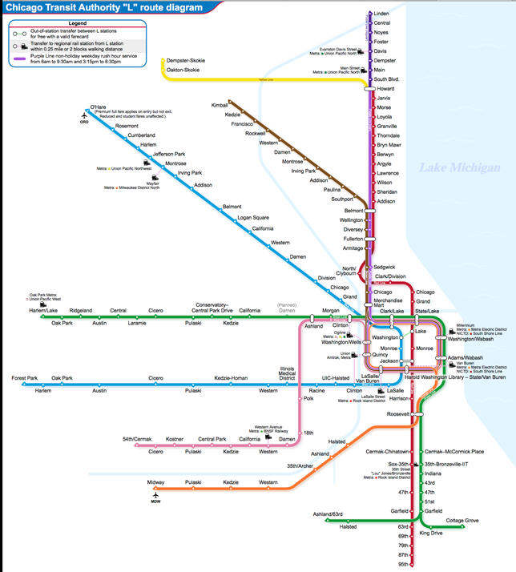
Introduction
BIG data! Very difficult to wrangle
List of columns with definitions in Appendix A
Chicago downtown center
8 rapid transit lines of the city, a.k.a. “L” lines

Slide 5
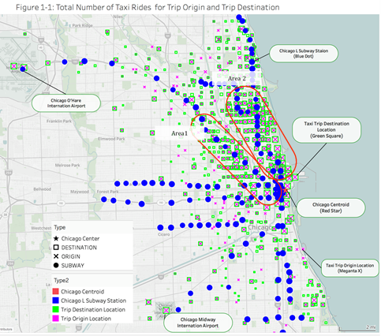
Analysis
Figure 1-1 displays the Chicago map with Chicago “L” Subway Lines station, trip origin, and trip destination
If taxis were complementing “L” routes, we’d expect to see a large concentration of drop-offs and pick-ups corresponding to the “L” terminals. However, Figure 1-1 shows the drop-offs and pick-ups in bands that are perpendicular to the “L” terminals
This suggests that taxis are detracting from “L” terminal business
i.e., taxi passengers are using taxis to get directly to specific locations

Slide 6
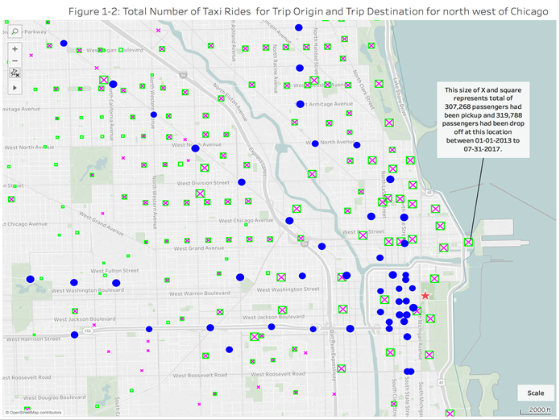
Analysis (cont’d)
Figure 1-2 displays the zoom area for Chicago north east region with map scale of 2000 ft. Most of locations for taxi pick up and drop passengers are a good distance away from “L” line station
The locations of taxi drop and pick off passenger are evenly distributed on the downtown area, especially the areas not covered by a subway station
This is a further indication that taxis are not covering similar routes as the “L” stations, but are detracting from “L” lines by getting people directly to and from downtown

Slide 7
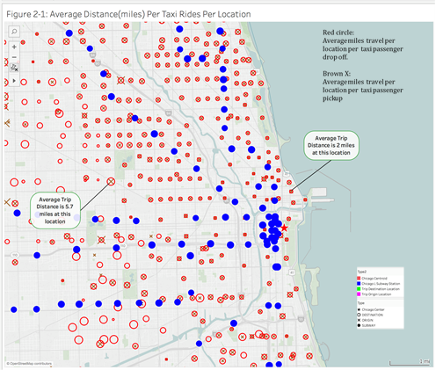
Analysis (cont’d)
Figure 2-1 displays the average distance traveled at each location for each passenger origin and destination. A bigger x or circle represents a longer distance traveled.
The data shows short trips around 2 miles average distance in the region of Chicago downtown. This is an indication that passengers use the taxi for short trips for the areas in downtown that are not covered by the subway.
This also supports the evidence in the previous two figures that taxi and “L” line routes are competing with each other (i.e., detracting).

Slide 8
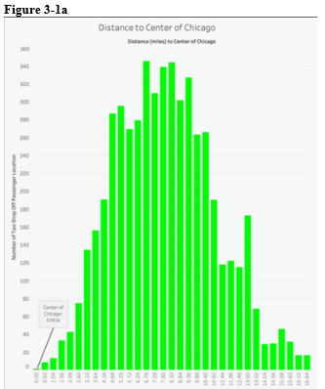
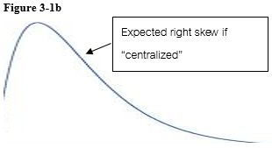
Analysis (cont’d)
Figure 3-1a shows a histogram of average distances from Chicago centroid in ½ mile increments along the x-axis and frequency of passenger drop-offs (in thousands) along the y-axis
If passenger drop-offs were “centralized”, then we would expect to see a heavy right skew in Figure 3-1a similar in shape to Figure 3-1b
However, Figure 3-1a appears to have a normal distribution. This suggests that the city of Chicago is not “centralized” when looking at taxi drop-offs

Slide 9
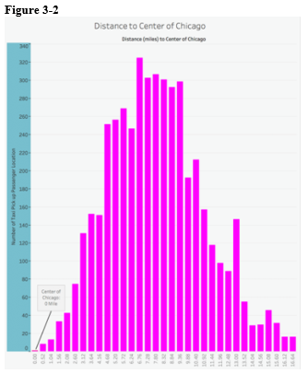
Analysis (cont’d)
Figure 3-2 on the next page shows the same histogram, but for taxi passenger pick-ups instead of drop-offs
As with the drop-offs, we would expect to see a heavy right skew to the pick-up histogram in order to be considered “centralized”
Again we see a normal distribution in Figure 3-2 and not the expected right skew as shown in Figure 3-1b

Slide 10
Conclusion
This analysis leads to conclusions that were not expected
Chicago, above all other U.S. cities (with the exception of perhaps New York), prides itself on the notion that its downtown is the hub of social and economic activity
boasts an impressive array of shopping, dining, and tourist attractions which are all densely packed around the Chicago centriod area
Therefore, one would expect that Chicago would be “centralized” with respect to taxi pick-ups and drop-offs
However, from the analysis presented and the histograms shown in figure series 3, this does not appear to be the case
Faced with this contradiction, it is reasonable to conclude that further analysis is warranted
would be interesting to perform this same analysis with extra tranches added to account for things like: seasonality, year, and weekdays versus weekends – just to name a few
might also consider how the histograms would look if Chicago’s two major airports were excluded altogether from the analysis

Slide 11
Conclusion (cont’d)
The biggest underlying factor that may be confounding this analysis may be socio-economic circumstance
those living in underserved areas are not represented in this data because they neither drive nor take taxis
The underserved may take only the “L” and then walk to their final destinations without ever (or rarely) taking a taxi
The northern parts of the city tend to be more affluent while the southern parts of the city tend to be more underserved
Referring back to Figure 1-1 we can see that the vast majority of taxi rides occur in the more affluent northern areas, while the southern underserved areas show much less taxi activity
Therefore, considering only taxi rides as a proxy to determine how “centralized” the city is may be only one component of a series of other missing factors that would be necessary to exhaustively analyze the main question that we seek an answer to in this analysis
A detailed step-by-step outline of how this analysis was performed is available at the GitHub link shown in the Reference section on the next slide
The authors of this paper would welcome anyone who wishes to further this research

Slide 12
References
Kaggle link to data set: https://www.kaggle.com/chicago/chicago-taxi-rides-2016/data
City of Chicago Data Portal: https://data.cityofchicago.org/d/wrvz-psew
GitHub Link: https://github.com/hdnguyen88/MSDS7330_GroupProject

Slide 13
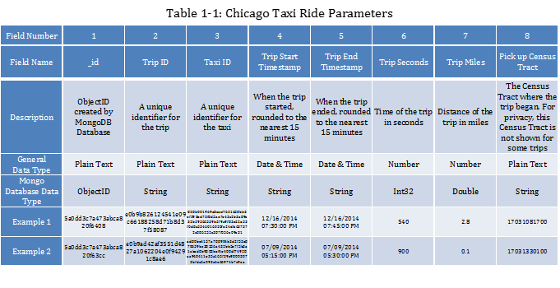
Appendix A

Slide 14
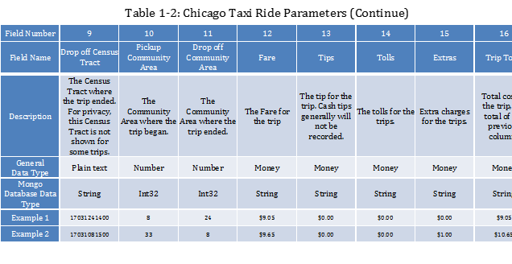
Appendix B

Slide 15
Appendix C

